Slide 1





Automated Tools
For System Analysis and Design

Slide 2
Automated Tools
For System Analysis and Design

Slide 3


PART 1
Introduction

Slide 4
PART 1
Introduction

Slide 5
Group Members
PART 1
Introduction
01
02
03
04
05
Nguyễn Thị Ngọc Ánh
1801040015
Trịnh Quang Huy
1801040106
Nguyễn Thị Ngà
1801040159
Nguyễn Thị Thảo
1801040209
Nguyễn Thu Trang
1801040226

Slide 6
Group Members
01
02
03
04
05
Nguyễn Thị Ngọc Ánh
1801040015
Trịnh Quang Huy
1801040106
Nguyễn Thị Ngà
1801040159
Nguyễn Thị Thảo
1801040209
Nguyễn Thu Trang
1801040226

Slide 7
Group Members
01
02
03
04
05
Nguyễn Thị Ngọc Ánh
1801040015
Trịnh Quang Huy
1801040106
Nguyễn Thị Ngà
1801040159
Nguyễn Thị Thảo
1801040209
Nguyễn Thu Trang
1801040226

Slide 8
Group Members
01
02
03
04
05
Nguyễn Thị Ngọc Ánh
1801040015
Trịnh Quang Huy
1801040106
Nguyễn Thị Ngà
1801040159
Nguyễn Thị Thảo
1801040209
Nguyễn Thu Trang
1801040226

Slide 9
PART 1
Introduction

Slide 10


CASE
Computer-aided Software Engineering
Automated software tools used by systems
analysts to develop information systems
Used to support or automate activities throughout the systems development life cycle (SDLC)
Increase productivity
Improve overall quality of systems
Link: https://en.wikipedia.org/wiki/Computer-aided_software_engineering

Slide 11
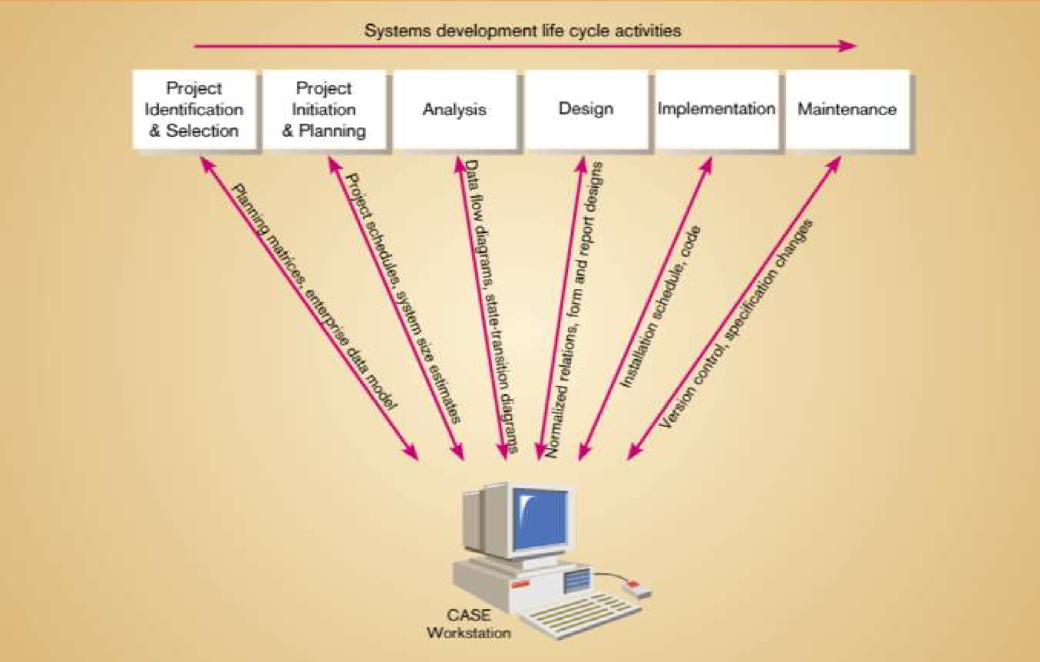
CASE Supports

Slide 12
Categories of CASE Products
Reverse engineering:
an artificial object reveal designs, architecture,
code, extract knowledge from the object.
deconstructed
Reengineering:
redesigning jobs, careers, processes
enhance quality, service, speed.
https://searchsoftwarequality.techtarget.com/definition/reverse-engineering
https://en.wikipedia.org/wiki/Reverse_engineering
https://vietnambiz.vn/tai-kien-thiet-reengineering-la-gi-dac-trung-va-lien-he-20191012022307932.htm

Slide 13


PART 2
The Use of CASE in Organizations

Slide 14

Improve quality of systems developed
Increase speed of development and design
Improve testing process through automated checking
Improve quality and completeness of documentation
Improve project management
Simply program maintenance
Promote reusability
Improve software portability

Slide 15

CASE and System Quality
Majority of organizations adopt CASE to improve speed and quality of systems development projects.
Widespread deployment has been slower than expected.
Several factors that inhibit widespread deployment

Slide 16

Cost
CASE tools one systems analyst
Return on Investment
Biggest benefits of CASE come in late stages of SDLC
Productivity Bottlenecks
Difficulty in providing tools for all states of SDLC
$5,000 - $15,000

Slide 17

The Outlook for CASE
Functionality is increasing
Cost is decreasing.
Reverse Engineering Tools
Automated tools that
read program source
code as input and
create graphical and
textual representations of
program design-level information.

Slide 18

PART 3
Components of CASE

Slide 19
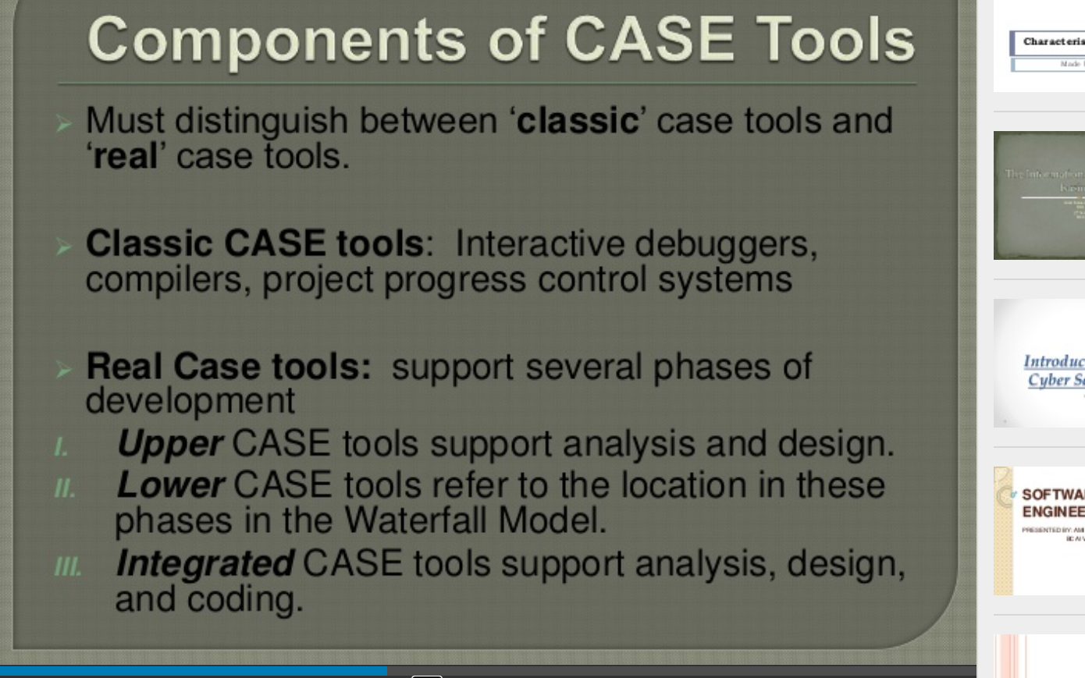
Components of CASE
Upper CASE
Lower CASE
Cross life-cycle CASE

Slide 20
Types of CASE tools
Diagramming tools
Computer display and report generators
Analysis tools
A central repository
Documentation generators
Code generators

Slide 21
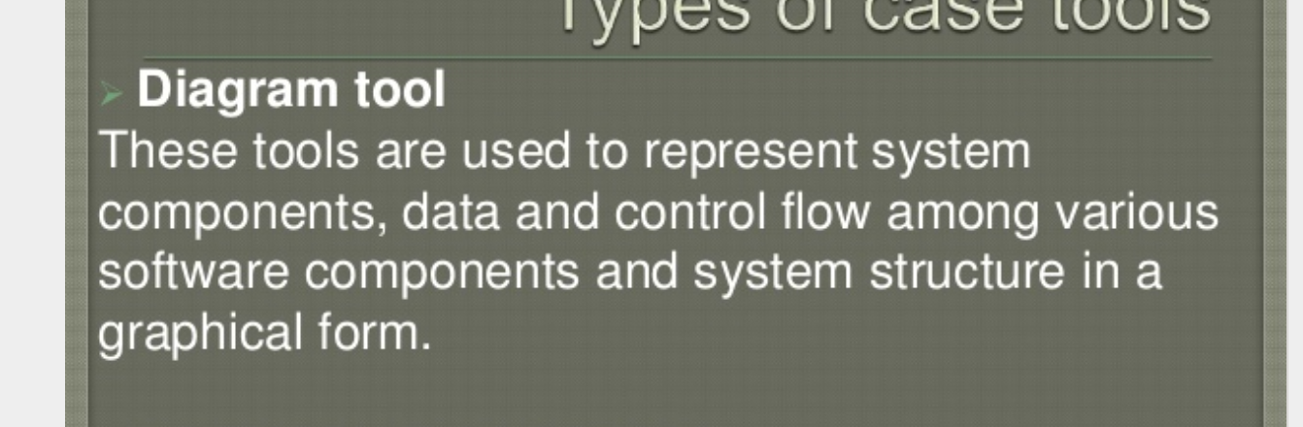
CASE Diagramming Tools
Several types of diagrams
Data Flow Diagrams (DFD)
Functional Hierarchy
Diagrams Entity-Relationship Diagrams

Slide 22
CASE Form & Report Generator Tools
Two Purposes:
Create, modify and test prototypes of computer display forms and reports
Identify which data items to display or collect for each form or report

Slide 23

CASE Analysis Tools
Creation of data flow and entity models
Establishing a relationship between requirements and models
Development of top-level design
Development of functional and process description
Development of test cases.
https://www.c-sharpcorner.com/UploadFile/nipuntomar/computer-aided-software-engineering-tools-case/

Slide 24
Difference between CASE-Based Systems Development and Traditional Systems Development
4

Slide 25
Weaknesses of Traditional Systems
Development
No support
for integration of
documents
Documentation after coding
Out-of-date documentation

Slide 26
Traditional Systems Development
CASE-Based Systems Development
Emphasis
Type
Coding
Documentation
Task
Maintain

Slide 27
THANK
YOU

